Slide 1
Vehicle Parking Management System
Team Members :
Suna Chaudhary
Santoshi Ayer
Yashoda Badu
Ravi Bhatt
Guided By :
Er.Birendra Singh Dhami

Slide 2
Overview
Introduction
Methodology
Literature Review
Feasibility
Expected Output
Conclusion

Slide 3
Introduction
Parking is something that almost everyone is familiar with and nearly all of us do every day. Parking is extremely needed since every trip with a vehicle start and ends in a parking a lot . However parking in polluted areas is something irritating that may increase driver’s stress levels ,affect their daily productivity , and dirty the environment . Parking management system is necessarily needed to influence drivers search time and cost looking for parking revenue , and traffic congestion.
Parking management system manage the details of duration , vehicle , parking slots , customers , parking fees . It minimize the effects of on street parking open road safety and congestion . The main objectives of this system are to provide best services to their customer , increasing working capacity , accuracy in calculation , better maintenance of the organization resources , up- to- date information accessibility and many more.

Slide 4
Methodology
For a vehicle parking management system , using the concept of C++ programming language , we created different classes using the concept of inheritance to know the details of duration , customer , parking fees , parking slots , types of vehicles and details of each vehicle . We created one class to identify the type of the vehicle and create another class vehicle as the child class of the vehicle type class. We also created a class for delete the details of vehicles is not necessary .

Slide 5
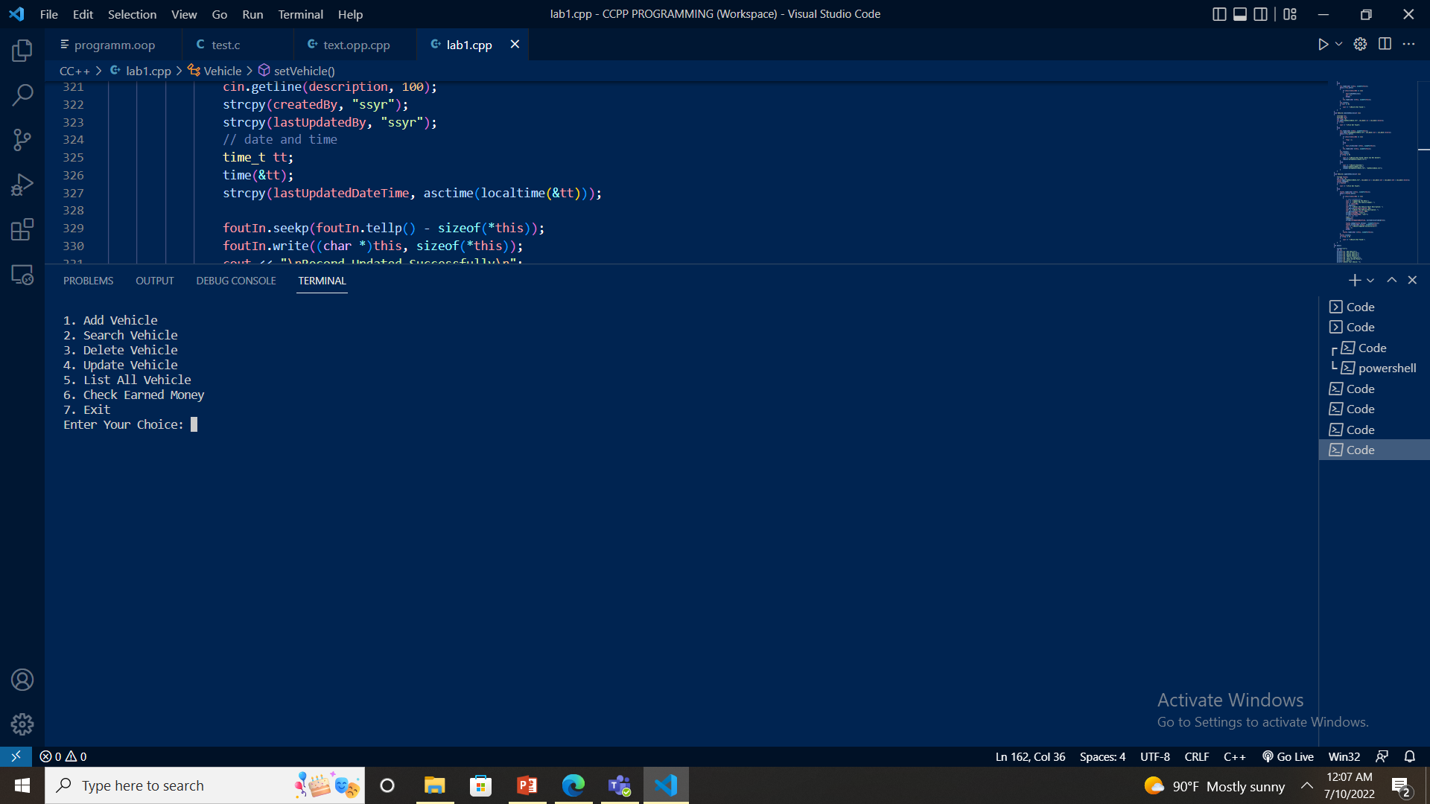

Slide 6
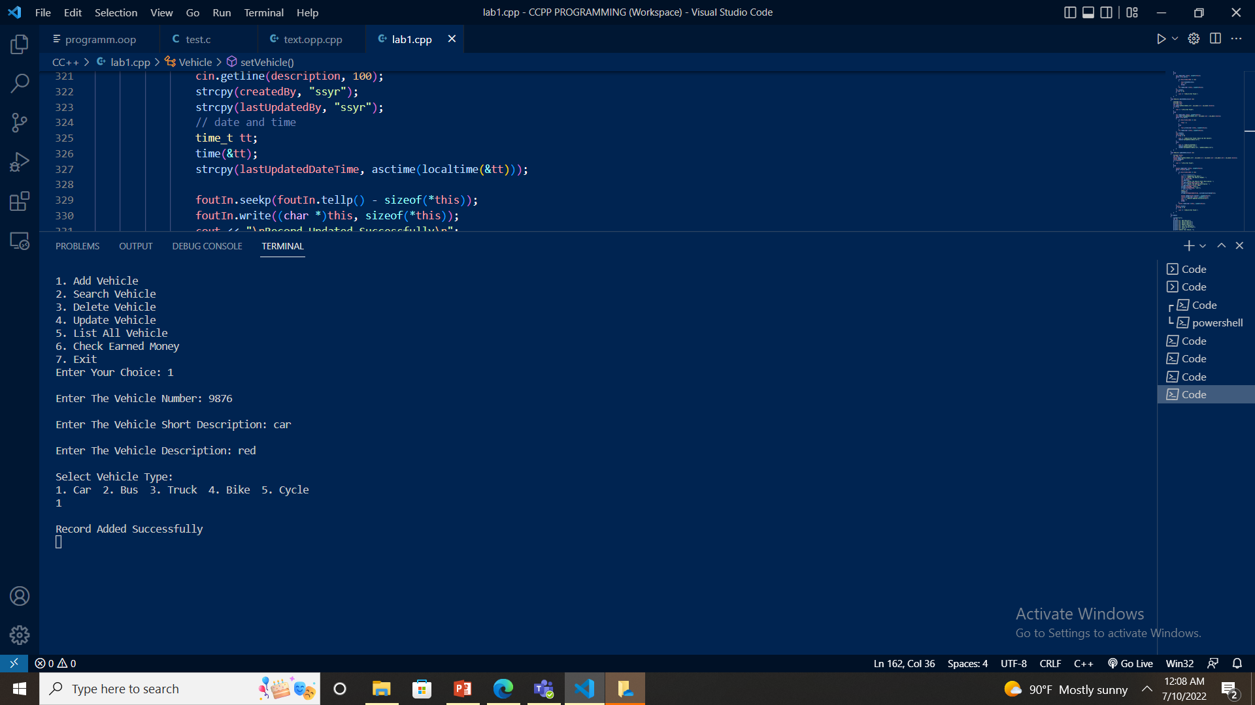


Slide 7
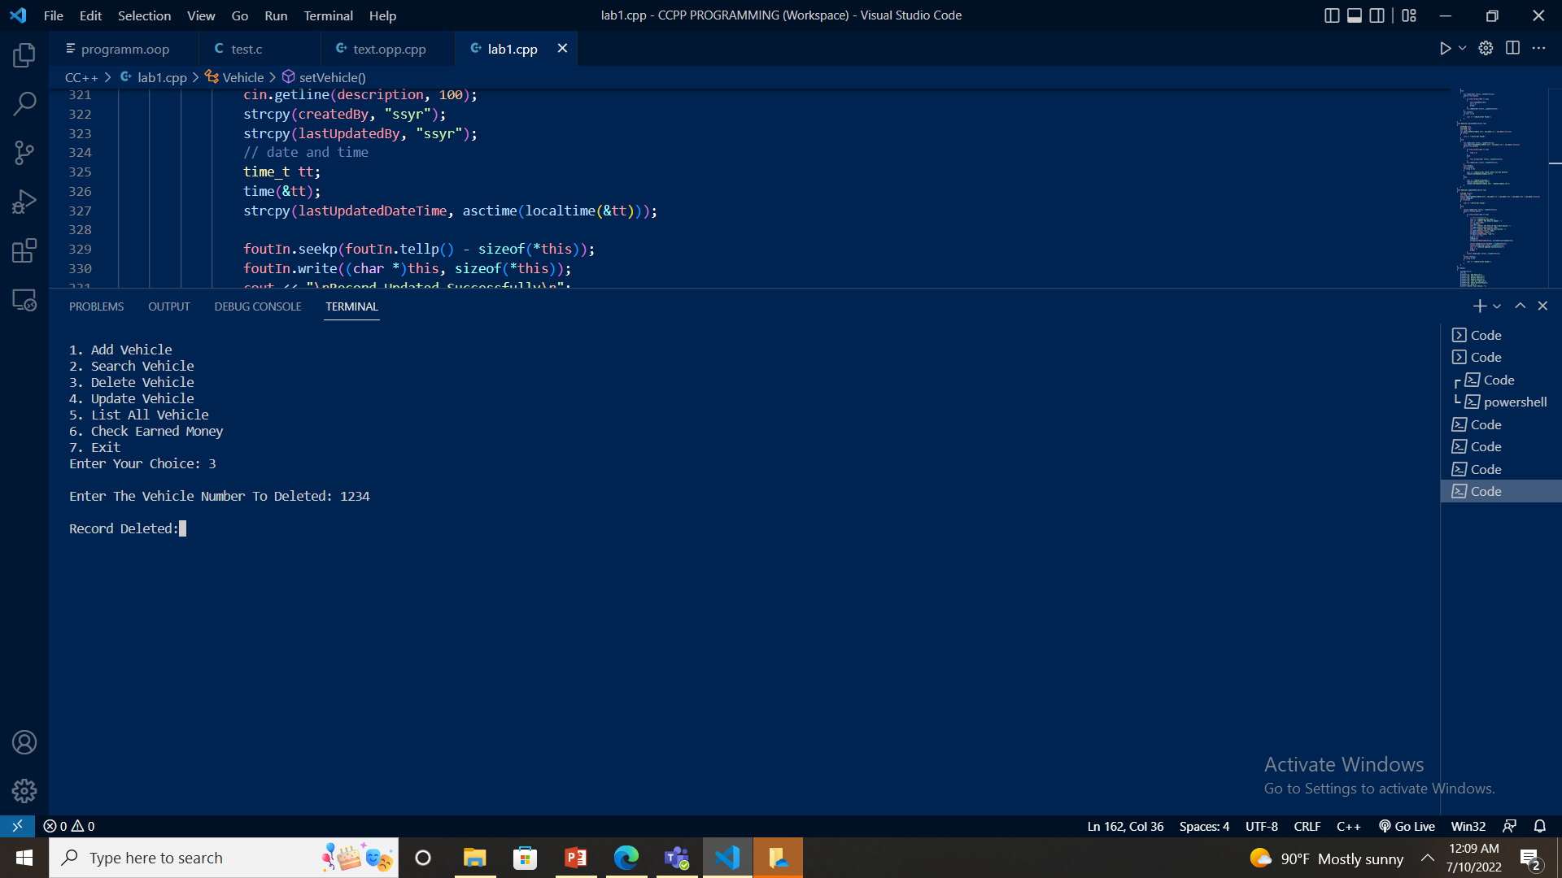
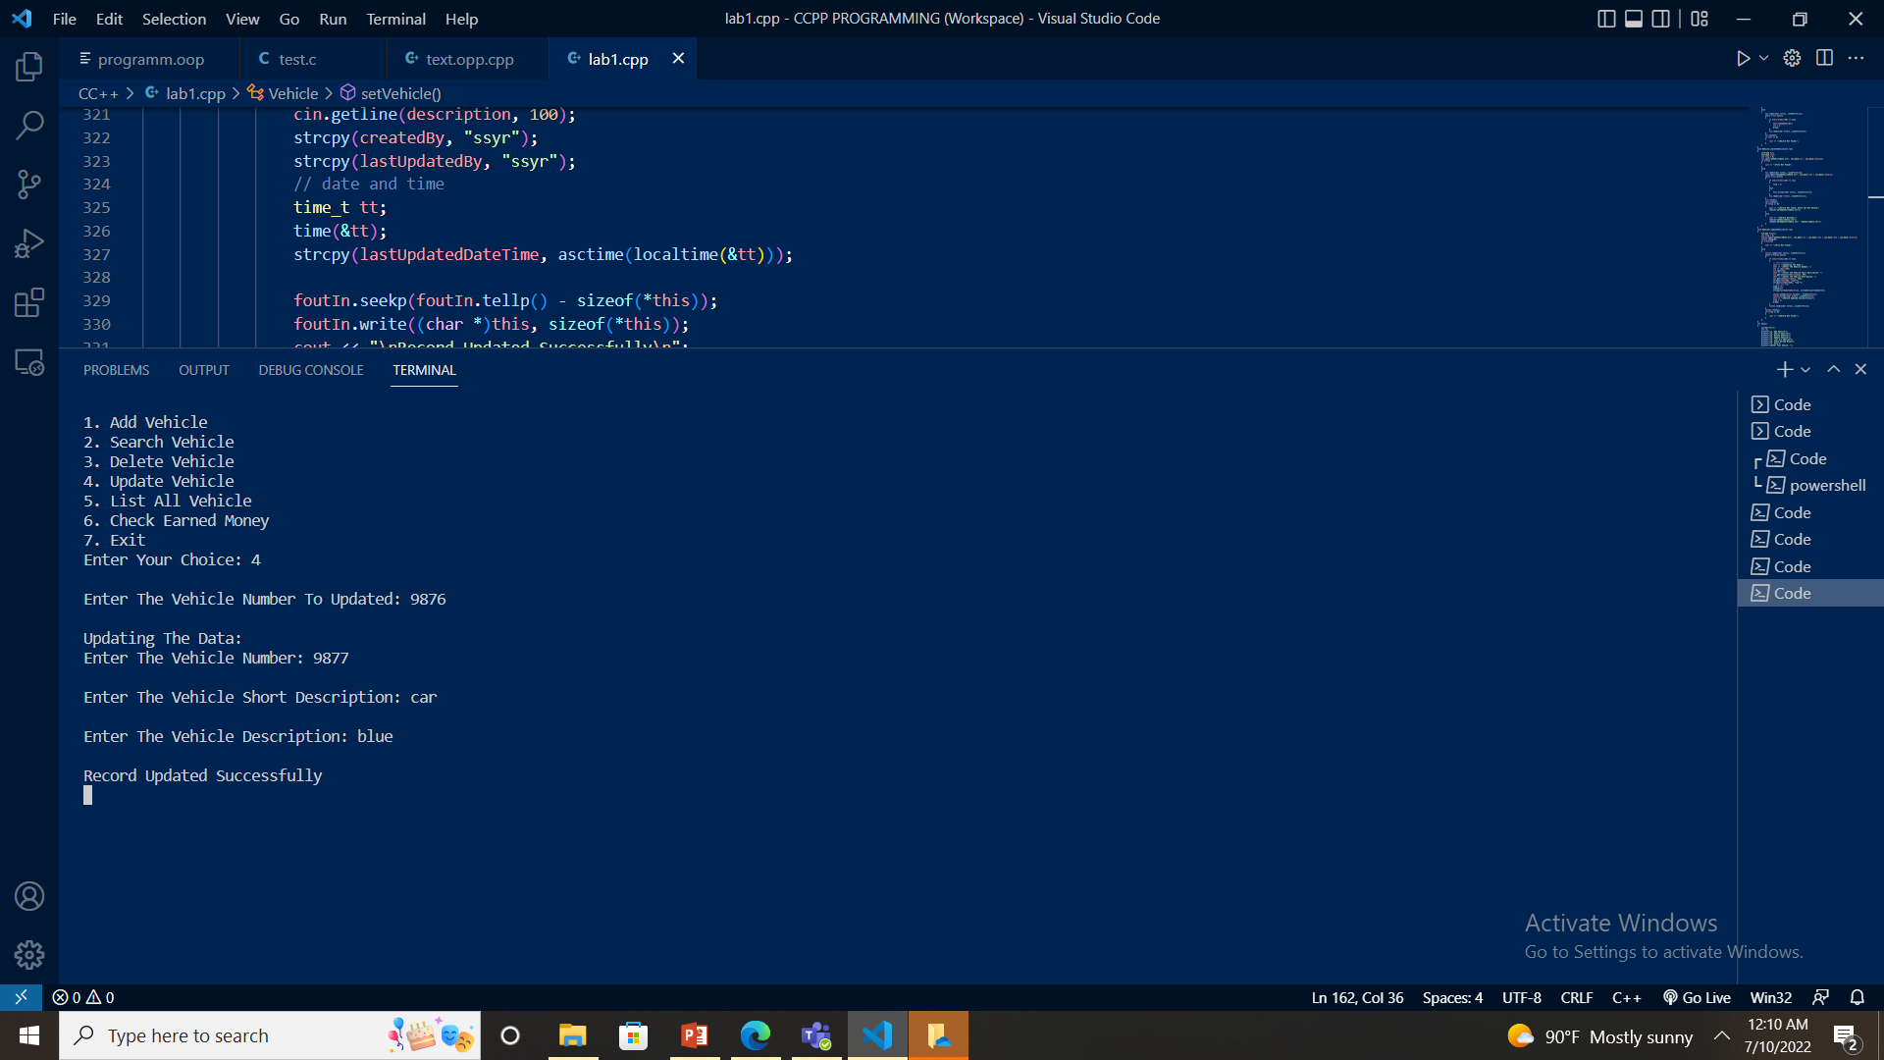

Slide 8
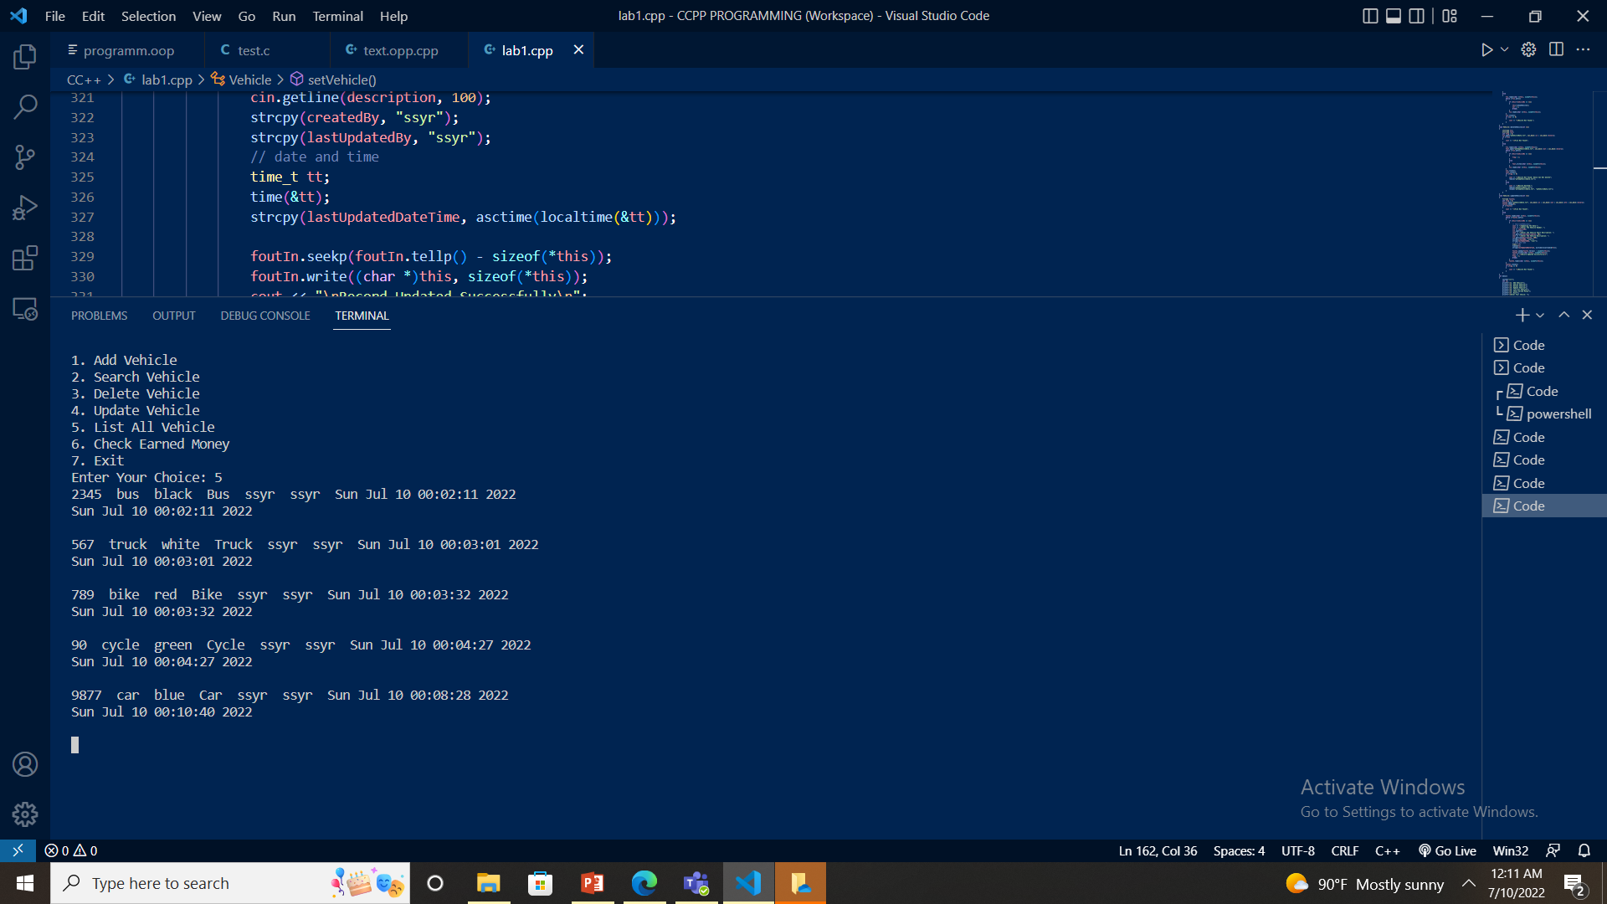

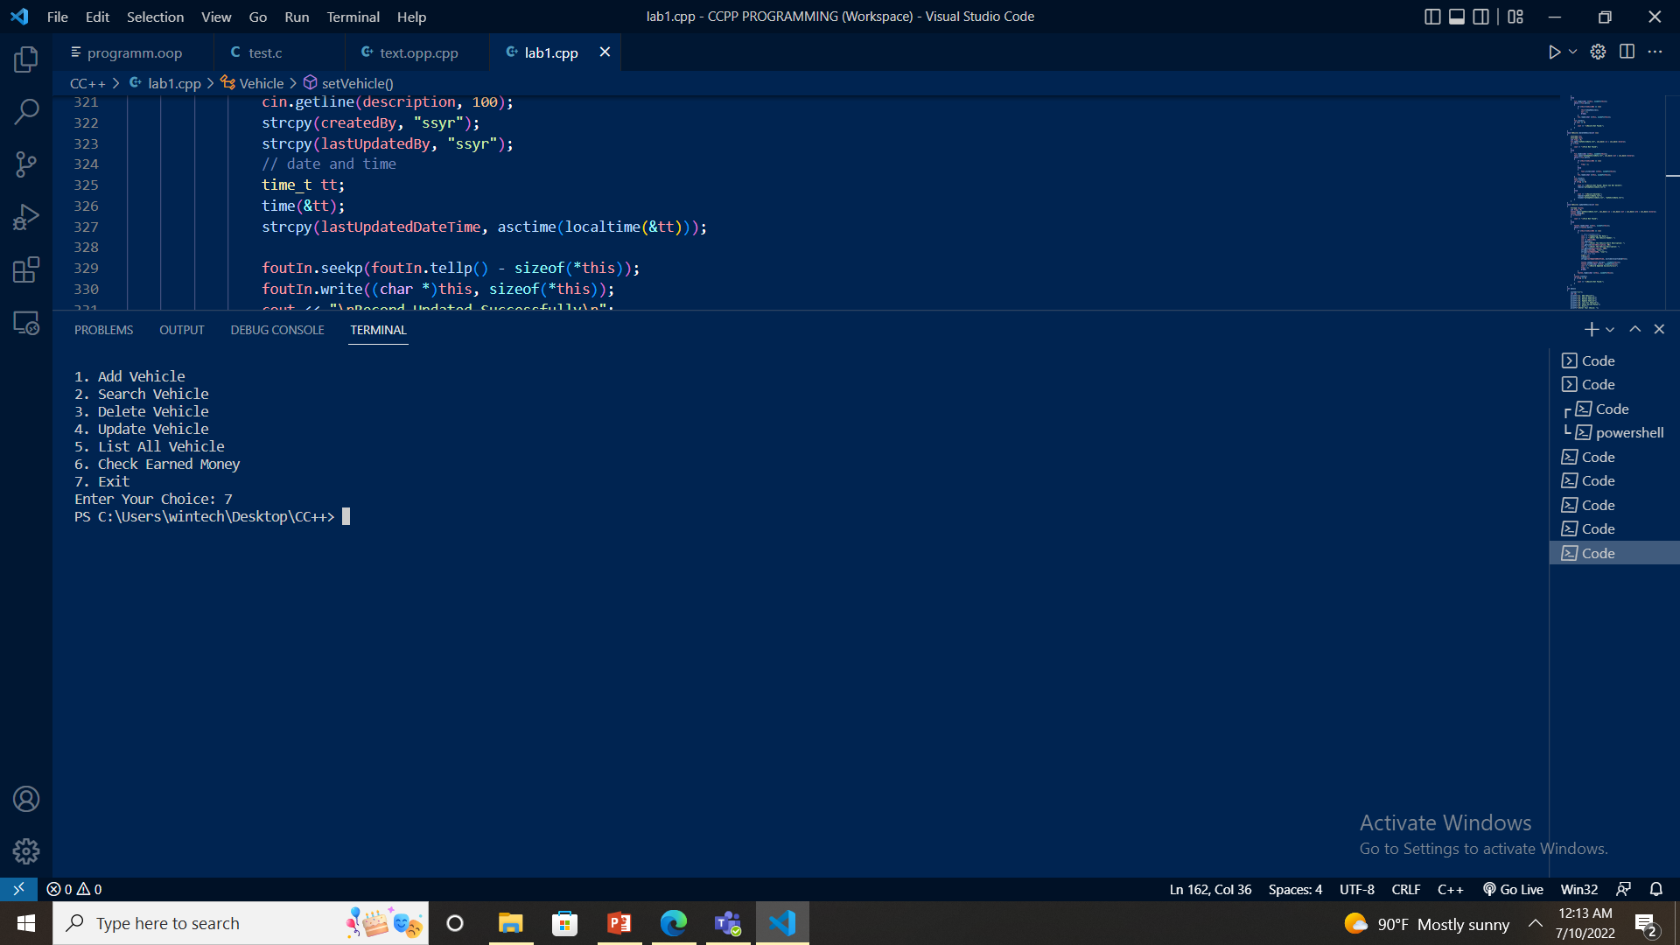

Slide 9
Feasibility
1.Economic feasibility : A system can be developed technically and that will be used if installed must still be a good investment for the organization . It does not require any addition hardware or software.
2.Technical feasibility : The technical issue usually raised during the feasibility stage of investigation . It provides the technical guarantee of accuracy , reliablity and security .
3.Operating Feasibility : The project is operationally feasible in a sense that this is done in a computer. So, the data are more secure than before.

Slide 10
Output

Slide 11
Conclusion
Parking management system significantly reduces the amount of time consumed in seeking the parking space , renders valuable data upon the availability of the parking area , accurate mapping of the parking space , offers guidance and suggestion for proper vehicle parking .

Slide 12
Thank You!

